Slide 1

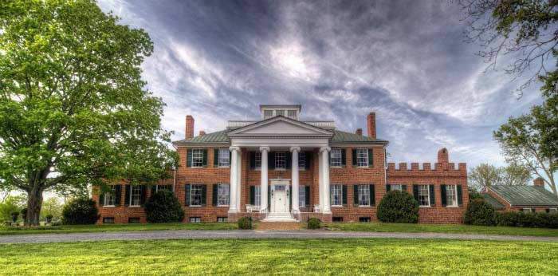
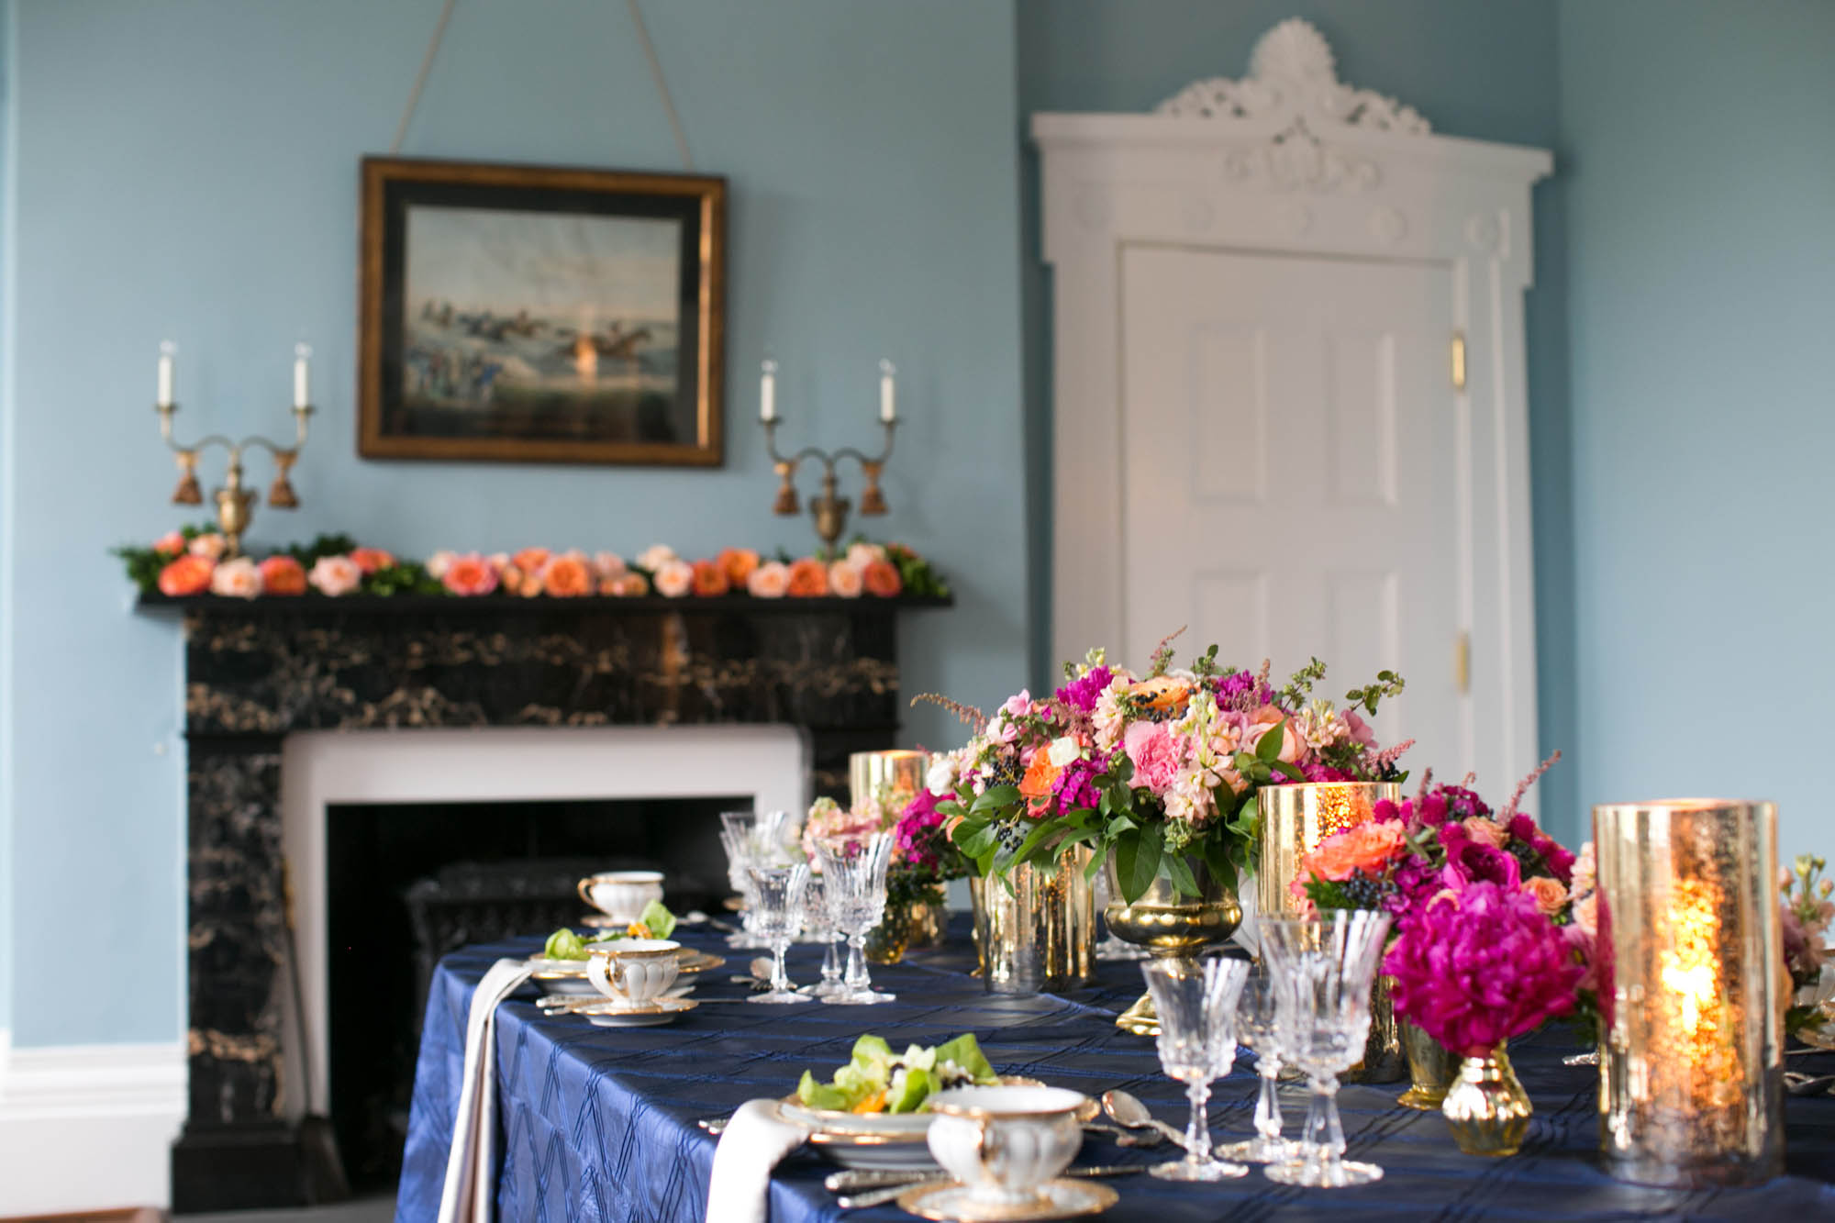
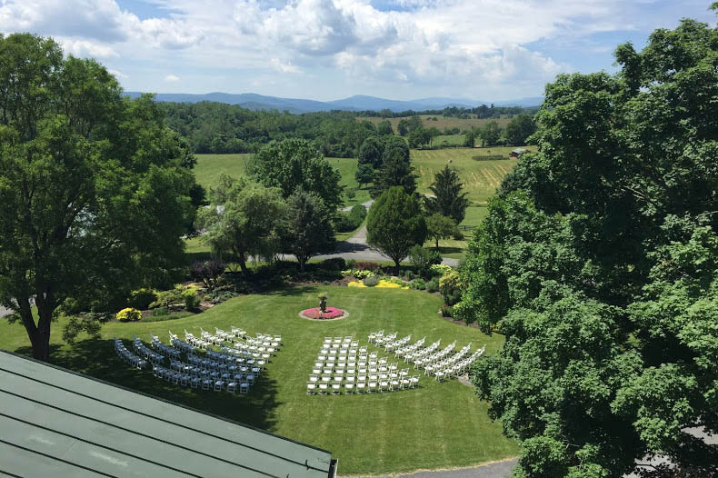
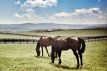





About History Horse Retirement Donate
Happenings Visit Weddings Event Rentals
Historic Long Branch
Long Branch Historic House and Farm is located on 400 acres in Boyce, Virginia, about an hour and half away from Washington, D.C. Our purpose is to preserve and utilize the assets of the Long Branch estate for the benefit of our local and regional communities. The historic house, active Virginia horse retirement farm and scenic open space allow us to promote education, environmental preservation and host community and private events. Our scenic gardens are the perfect location for Virginia weddings, and the house is the ideal Virginia wedding venue during inclement weather. Whether touring the home, enjoying a picnic on our beautiful grounds, hiking or walking our pristine property at the base of the Blue Ridge Mountains, you will be sure to want to visit again.
Upcoming Events
Weddings
Horse Retirement
830 Long Branch Lane
P.O. Box 241
Millwood, VA 22646
540-837-1856
info@visitlongbranch.org

Slide 2
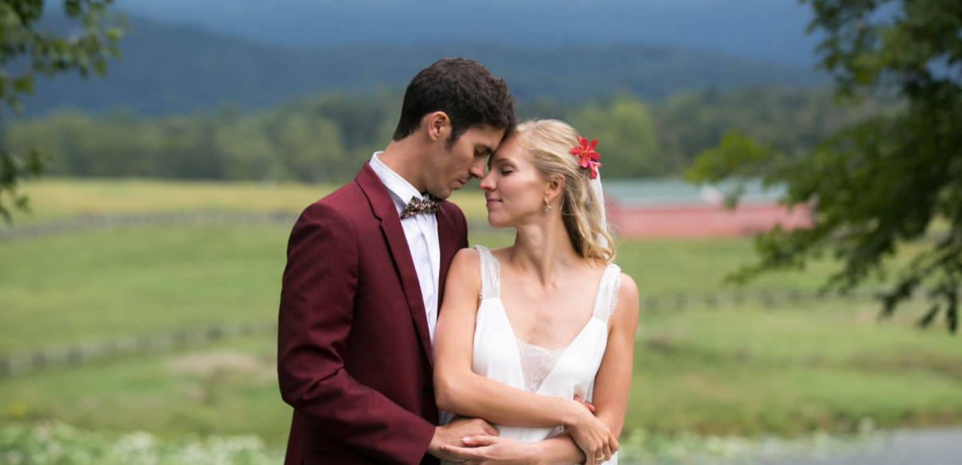
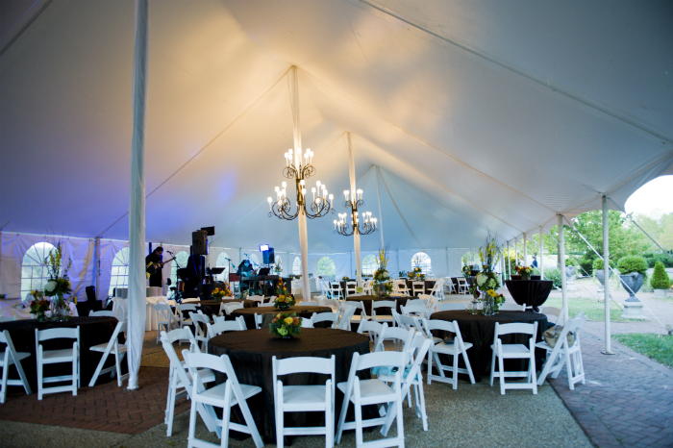
About History Horse Retirement Donate
Happenings Visit Weddings Event Rentals
Weddings at Historic Long Branch
Long Branch Historic House and Farm is located on 400 acres in Boyce, Virginia, about an hour and half away from Washington, D.C. Our purpose is to preserve and utilize the assets of the Long Branch estate for the benefit of our local and regional communities. The historic house, active Virginia horse retirement farm and scenic open space allow us to promote education, environmental preservation and host community and private events. Our scenic gardens are the perfect location for Virginia weddings, and the house is the ideal Virginia wedding venue during inclement weather. Whether touring the home, enjoying a picnic on our beautiful grounds, hiking or walking our pristine property at the base of the Blue Ridge Mountains, you will be sure to want to visit again.
Inside the Mansion
Grounds
Event Spaces
830 Long Branch Lane
P.O. Box 241
Millwood, VA 22646
540-837-1856
info@visitlongbranch.org

Slide 3
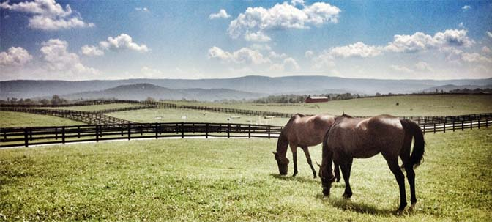
About History Horse Retirement Donate
Happenings Visit Weddings Event Rentals
Horse Retirement at Historic Long Branch
Long Branch Historic House and Farm is a Virginia horse retirement facility that truly provides the ideal setting for horses lucky enough to be “put out to pasture” on our beautiful horse farm in the Shenandoah Valley. Located 20 miles west of Middleburg, VA, Long Branch’s horse retirement farm is the perfect location for your horse.
We specialize in the care of retired horses and your horse is the primary focus of our Virginia horse retirement farm. Our staff understands that older horses require a different kind of care than those in work. To that end, we employ a staff of experienced horsemen, some of whom live on the grounds, making it a safe environment for your horse should an incident occur at any time of day or night.
PHOTO
PHOTO
PHOTO
Boarding Application
Pay Your Monthly Bill
Request A Tour
830 Long Branch Lane
P.O. Box 241
Millwood, VA 22646
540-837-1856
info@visitlongbranch.org

Slide 4
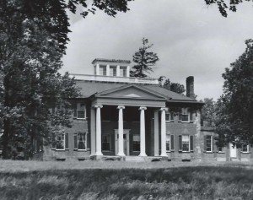
About History Horse Retirement Donate
Happenings Visit Weddings Event Rentals
History at Historic Long Branch
Long Branch survived the Civil War, the Reconstruction era, the Great Depression, and two world wars. Named a Virginia Historic Landmark in 1968 and listed in the National Register of Historic Places in 1969, Long Branch is significant for its relation to national, regional, and local historical narratives.
In 1788, Robert Carter Burwell, a descendant of Robert “King” Carter, inherited the land sitting along a stream known as Long Branch in Clarke County, Virginia. Utilizing the labor of enslaved workers, Burwell started a wheat plantation on the land he inherited. About twenty years later, around 1810, he began to construct a mansion on the site. Burwell, along with the help of a local builder-architect, designed and constructed the house following the classical principles suggested to him by Benjamin Henry Latrobe, architect of the U.S. Capitol, in a letter dated July 21, 1811. Latrobe recommended that Burwell include a servant’s staircase and that the dining room and chamber be oriented to the south side of the house.
While it is unclear if Burwell was able to incorporate all of Latrobe’s recommendations into the final design of Long Branch, he did include the servant’s staircase that can still be seen today. Burwell did not have much time to enjoy his new home, for he fell fatally ill in the filthy camps around Norfolk, Virginia while serving in the military during the War of 1812.
Following Burwell’s death, the property passed into the ownership of his sister, Sarah, and her husband Philip Nelson. While Burwell had died in 1813, it appears that the Nelson’s did not move in until around 1820. Details on their early tenancy are scarce, but by the 1830s sources indicate they operated the house as a school for girls and maintained the grounds as a wheat plantation. Philip’s son Thomas then opened a boy’s school at Rosney, the plantation home immediately north of Long Branch. It is likely that Philip was responsible for the addition of an open-air loggia to the house – the eastern brick addition.
830 Long Branch Lane
P.O. Box 241
Millwood, VA 22646
540-837-1856
info@visitlongbranch.org

